Slide 1
Case Interview Frameworks
Overview
Determine Key Issue(s)
Develop Hypotheses
Gather Data / Test Hypotheses
Develop Options
Make Recommendation
Refine Answer
As the interviewer describes the situation, think about what are the key issues facing general management
Develop hypotheses
Decide what data you need to better understand the issues
Listen to the facts
Evaluate which facts are critical to the key issues
Probe for more detail in critical areas
Use facts and numbers appropriate in building argument
Summarize options before making recommendation
State pros and cons - be fact driven
Make your recommendation

Slide 2
Case Interview Frameworks
Using Frameworks
There is no golden rule, more than one framework may be applicable
Use an appropriate framework
Do not force a framework
Be hypotheses driven
Be prepared to revise your hypotheses
Mutually Exclusive and Collectively Exhaustive (MECE)
Listen for clues from the interviewer
Accept direction from the interviewer
Display your thinking visually / graphically
Be transparent in your analysis
Leave time to summarize and make recommendations

Slide 3
Case Interview Frameworks
Some General Frameworks
The Three C’s
The Four P’s
Porter’s Five Forces (+govt.)
Supply & Demand
The Profit Equation
Internal - External
NPV Analysis
Don’t be afraid to create your own framework, as long as it is logical, appropriate and transparent to the interviewer.

Slide 4
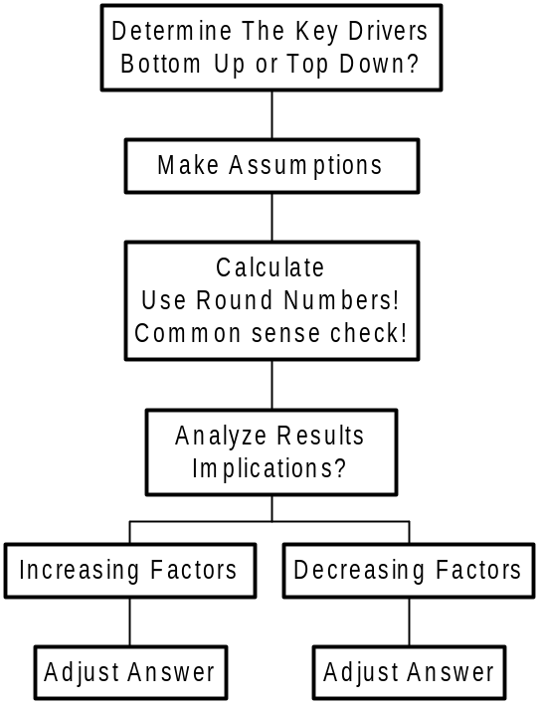
Case Interview Frameworks
Market Sizing

Slide 5
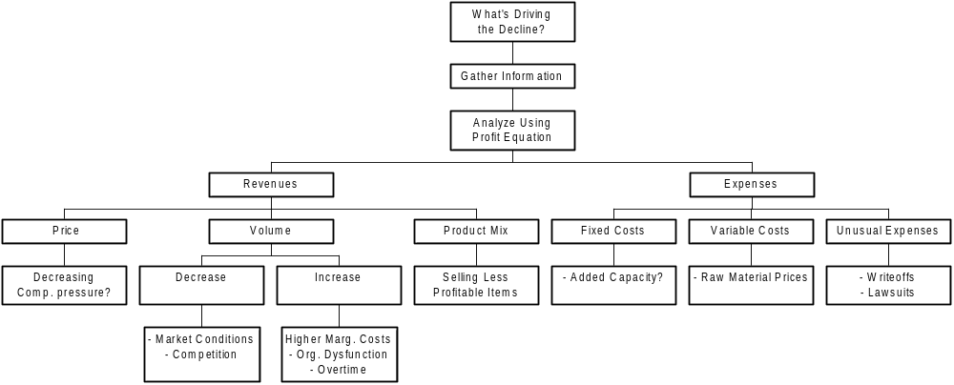
Case Interview Frameworks
Declining Profits

Slide 6
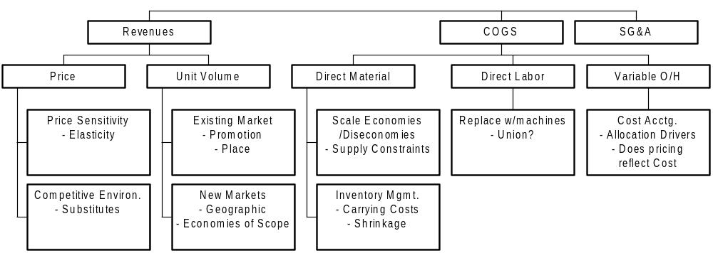
Case Interview Frameworks
Increase Profitability
Can we explore economies of scope with entry into adjacent industry?

Slide 7
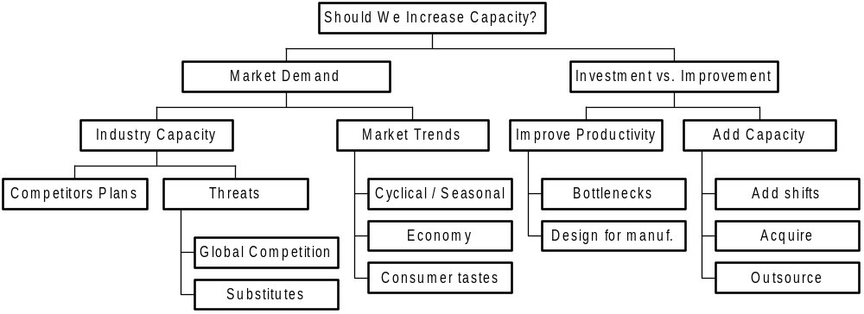
Case Interview Frameworks
Increase Capacity?

Slide 8
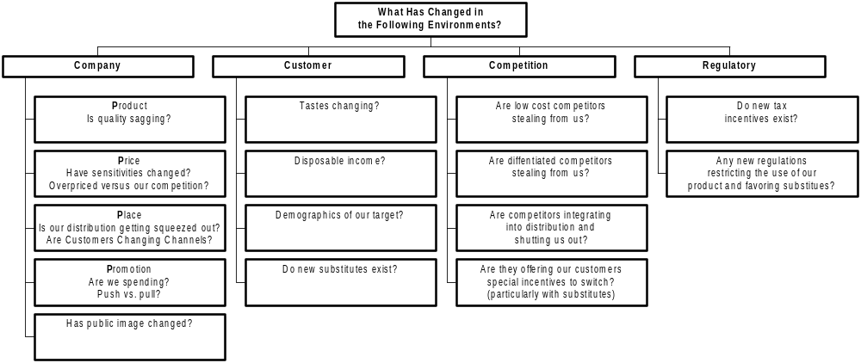
Case Interview Frameworks
Customer Turnover

Slide 9
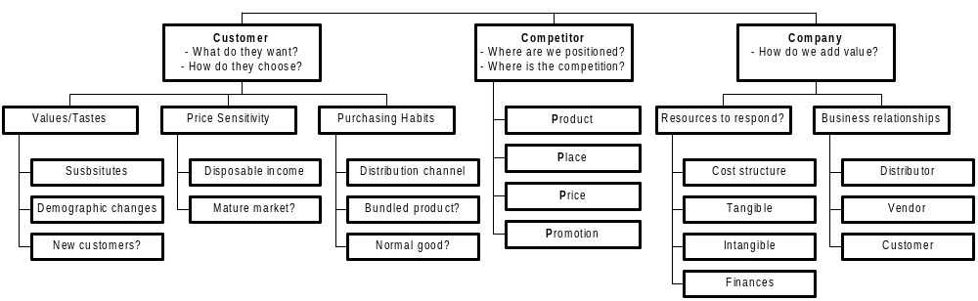
Case Interview Frameworks
Competitive Response
Given the above, is it worth making a competitive response?
How will the competition react?
Applying game theory or PARTS analysis may help.

Slide 10
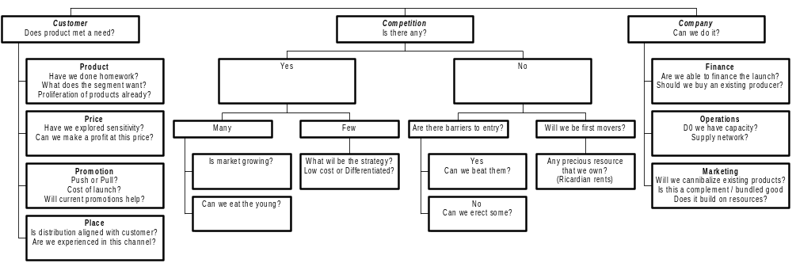
Case Interview Frameworks
New Product Introduction?

Slide 11
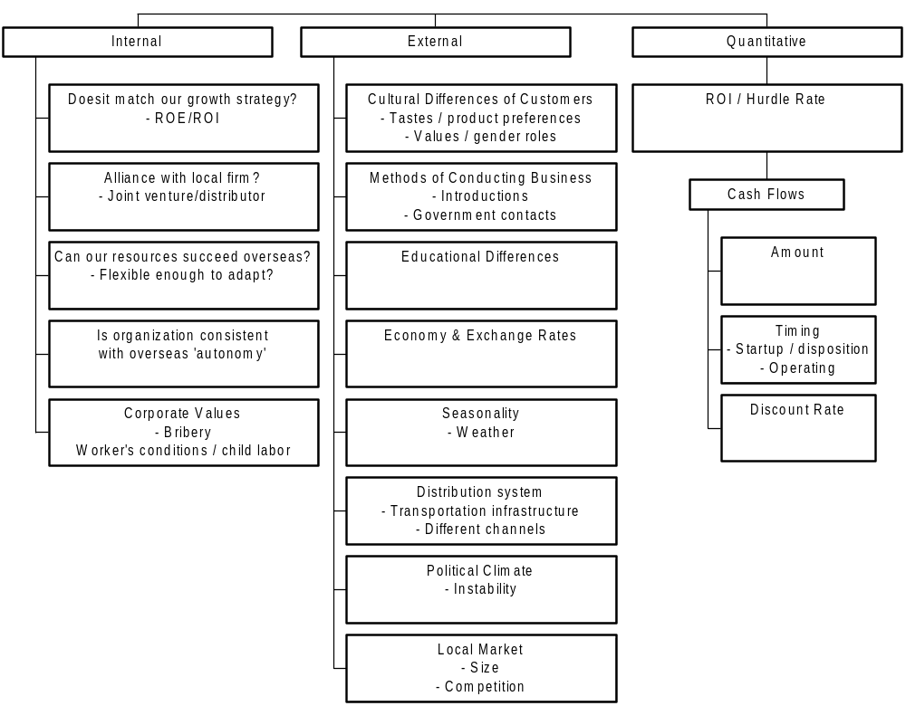
Case Interview Frameworks
International Expansion

Slide 12
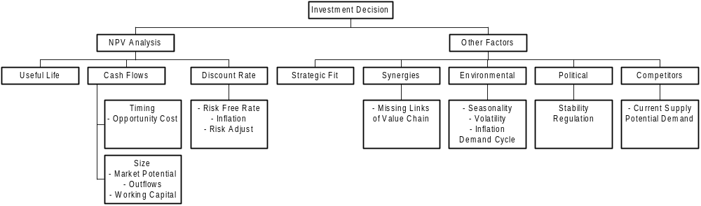
Case Interview Frameworks
Investment Decision

Slide 13
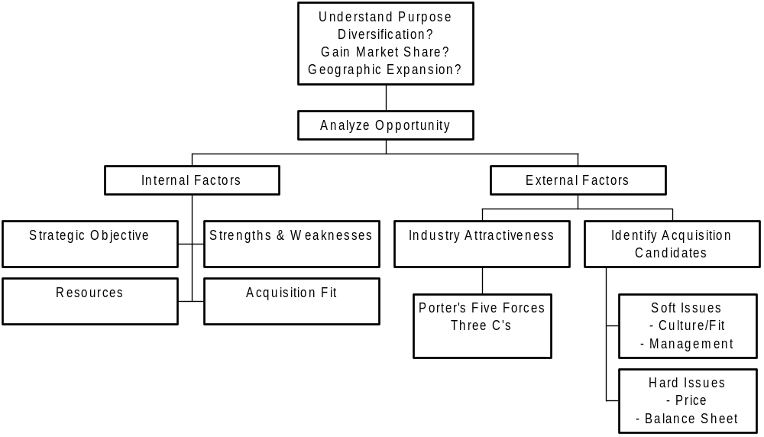
Case Interview Frameworks
Company Acquisition

Slide 14
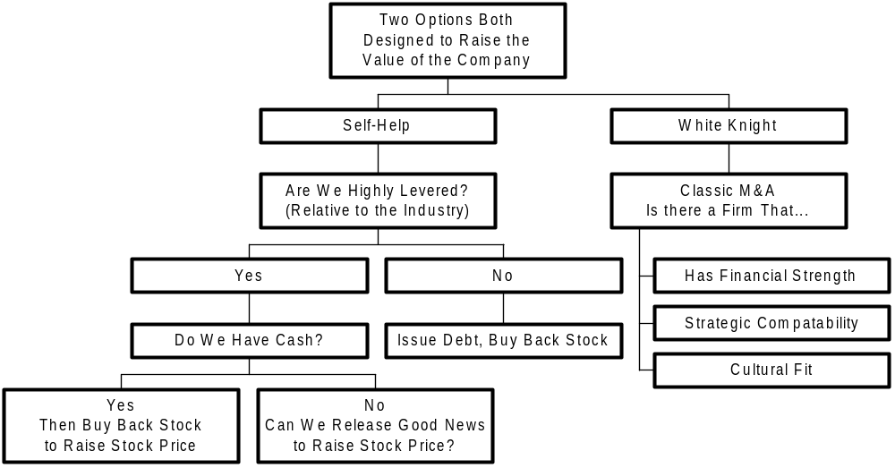
Case Interview Frameworks
Hostile Takeover Defense

